Slide 1
Boosting Algorithms

Slide 2
ADA Boosting
AdaBoost works by weighting the instances in the training dataset based on the accuracy of previous classifications.
These algorithms boost prediction power by transforming a large number of weak learners into strong learners
Boosting algorithms work on the idea of first building a model on the training dataset and then building a second model to correct the faults in the first model. This technique is repeated until the mistakes are reduced and the dataset is accurately predicted. Boosting algorithms function similarly in that they combine numerous models (weak learners) to produce the final result (strong learners).

Slide 3
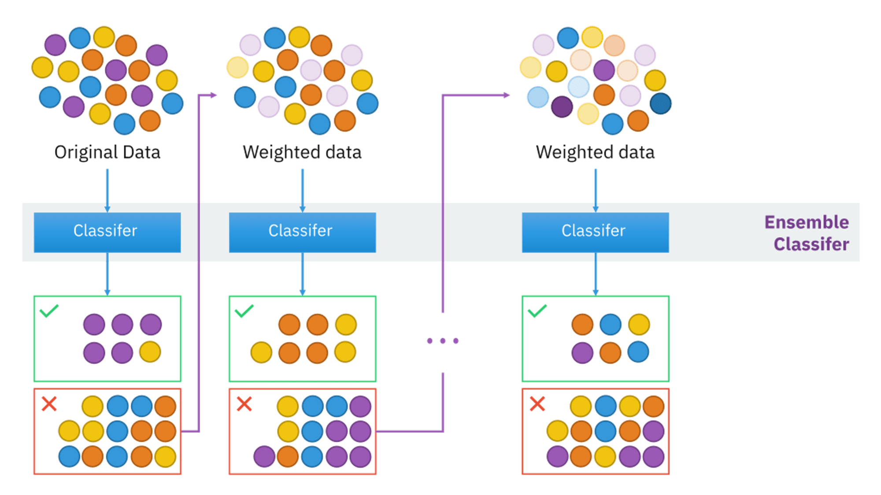
ADA Boosting

Slide 4
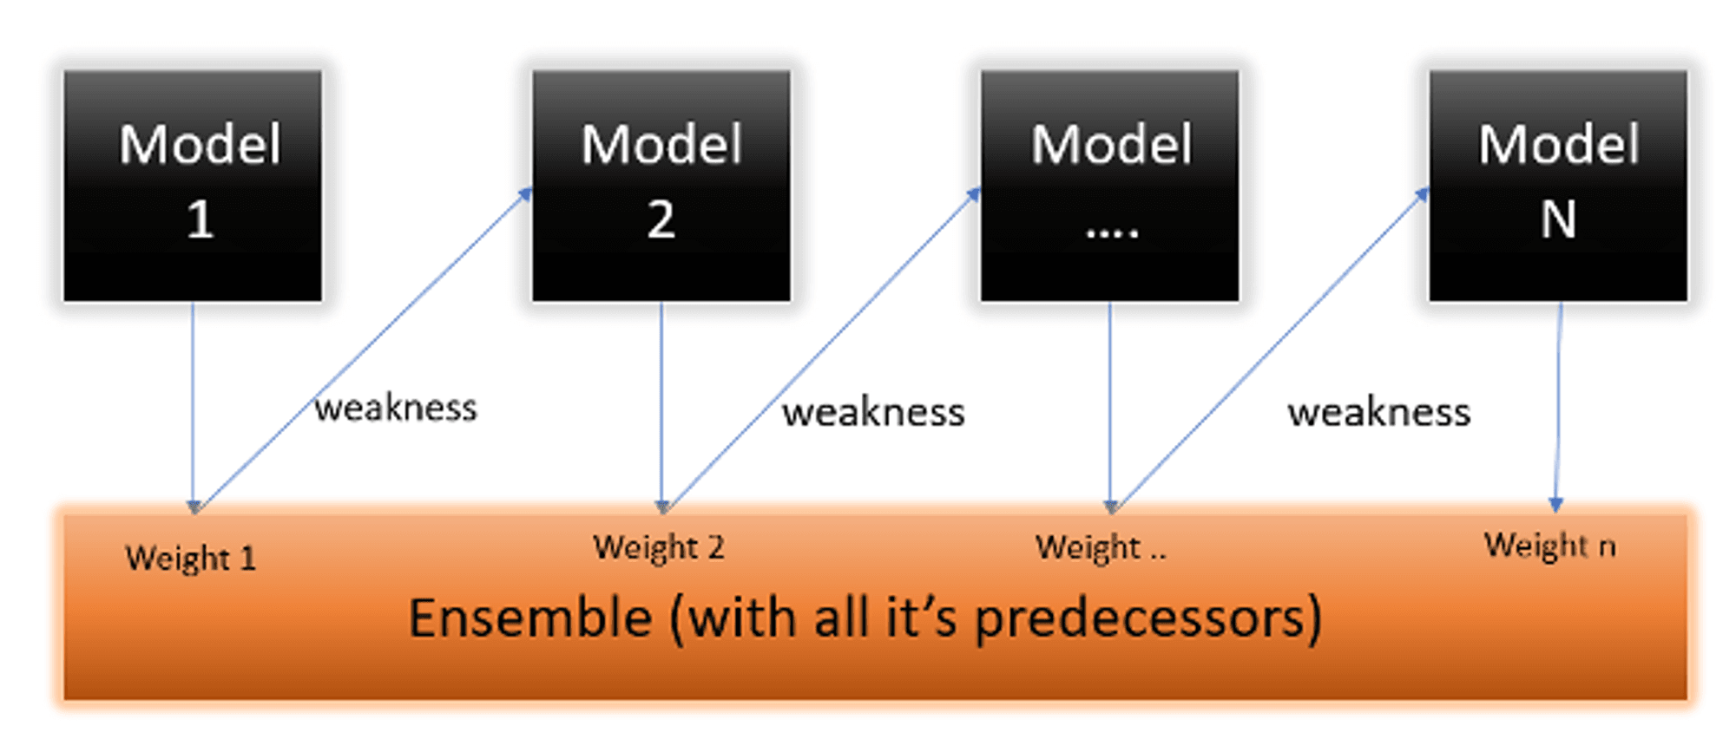
Ada Boosting

Slide 5
XGBoosting
XGBoost (eXtreme Gradient Boosting) is a machine learning algorithm that focuses on computation speed and model performance.The algorithm can be used for both regression and classification tasks and has been designed to work with large and complicated datasets.
The model improves sequentially but not in incremental weight concept
Optimize the loss function(error) from previous learner
Using Additive Model for regularize loss function
Distributed machine learning process
More computational speed and model efficiency

Slide 6
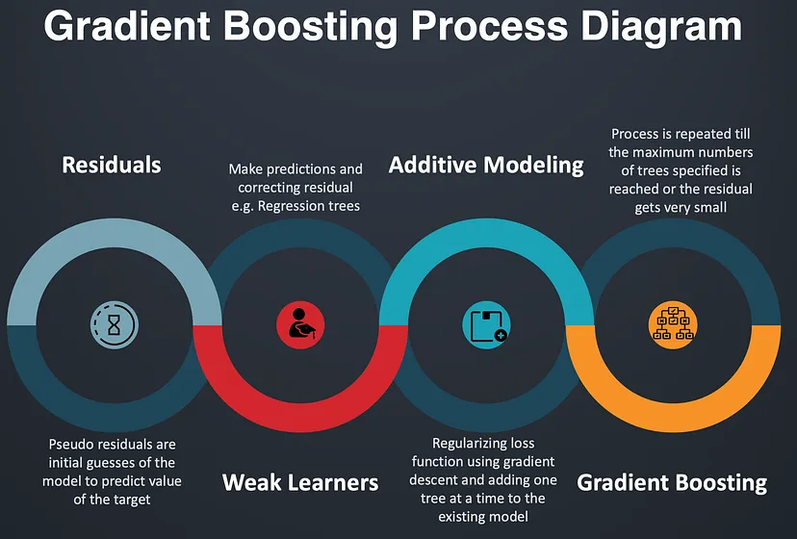
XG Boosting

Slide 7
LGBM
Light GBM is very fast when compared to XGBOOST and is a much better approach when dealing with large datasets
Poor in small dataset
It uses histogram-based method selecting best fit
For continues values split-up into bin or buckets

Slide 8
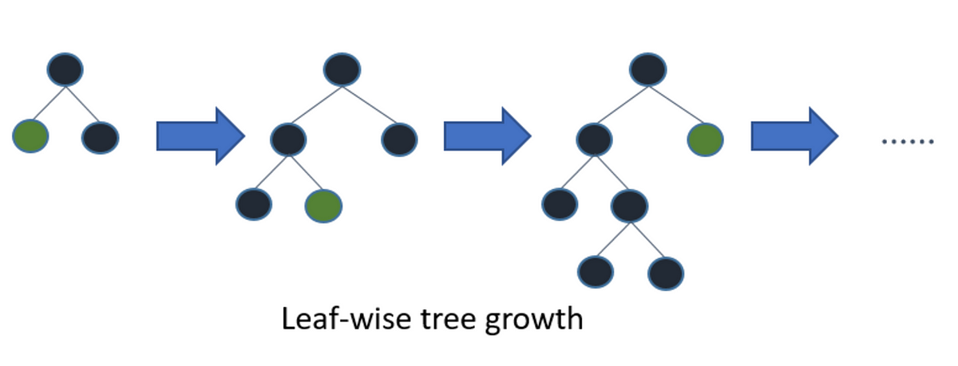
LGBM

